Slide 1
CSCI 272 Lesson 5 (Deitel 13.1 - 13.8)

Slide 2
Objectives
Streams
Stream Output
Stream Input
Unformatted I/O
Stream Error States

Slide 3
Streams
C++ I/O occurs in streams, which are sequences of bytes.
In input operations, the bytes flow from a device (e.g., a keyboard, a disk drive, a network connection) to main memory.
In output operations, bytes flow from main memory to a device (e.g., a display screen, a printer, a disk drive, a network connection).
The bytes could represent characters, raw data, graphics images, digital speech, digital music, digital video or any other information an application may require. The system I/O mechanisms should transfer bytes from devices to memory (and vice versa) reliably. The time these transfers take typically is far greater than the time the processor requires to manipulate data internally. I/O operations require careful planning and tuning to ensure optimal performance.

Slide 4
Streams
C++ provides both “low-level” and “high-level” I/O capabilities. Lowlevel I/O capabilities (i.e., unformatted I/O) specify that some number of bytes should be transferred device-to-memory or memory-todevice. In such transfers, the individual byte is the item of interest. Such low-level capabilities provide high-speed, high-volume transfers but are not particularly convenient.
Programmers generally prefer a higher-level view of I/O (i.e., formatted I/O), in which bytes are grouped into meaningful units, such as integers, floating-point numbers, characters, strings and userdefined types. These type-oriented capabilities are satisfactory for most I/O other than high-volume file processing.

Slide 5
Streams
The C++ stream libraries provide hundreds of I/O capabilities. Most of our C++ programs include the <iostream> header, which declares basic services required for all stream-I/O operations.
The <iostream> header defines the cin , cout , cerr and clog objects, which correspond to the standard input stream, the standard output stream, the unbuffered standard error stream and the buffered standard error stream, respectively—cerr , clog.

Slide 6
Streams
int main() {
// Standard input (cin) and standard output (cout)
int number;
std::cout << "Enter a number: ";
std::cin >> number;
std::cout << "You entered: " << number << std::endl;
//Standard error (cerr). This is typically used for error messages and is
//unbuffered, so messages appear immediately.
std::cerr << "This is an error message." << std::endl;
//Standard log (clog) Similar to cerr, but buffered, which means messages may not
//appear immediately.
std::clog << "This is a log message." << std::endl;
return 0;
}

Slide 7
Streams
The <iomanip> header in C++ provides tools to control and format input and output operations. It allows you to format data displayed in the console, such as adjusting the width of columns, setting precision for floating-point numbers, and aligning text.
Some of the commonly used functions and manipulators include:
std::setw(int n): This manipulator sets the field width for the next output operation. It specifies the minimum number of characters to use for the next data item.
std::setprecision(int n): This manipulator sets the precision (number of decimal places) for floating-point numbers.
std::left: This manipulator aligns output text to the left within the specified field width.
std::right: This manipulator aligns output text to the right within the specified field width (default alignment).
std::setfill is commonly used to set the fill character for the output, which specifies the character used to fill the width of a field when the actual data doesn't use up the entire field width

Slide 8
Streams
int main() {
double pi = 3.14159265359;
int age = 25;
std::string name = "Alice";
//Using std::setw to set field width and std::setfill to set fill character
std::cout << std::setw(10) << std::setfill('-') << "Name:" << std::setw(15) <<
std::left << name << std::right << "Age:" << std::setw(5) << age << std::endl;
// Using std::setprecision to set precision for floating-point number
std::cout << "Pi with precision 2: " << std::setprecision(2) << pi << std::endl;
// Reset precision to default
std::cout << std::setprecision(6);
return 0;
}

Slide 9
Streams
The iostream library provides many class templates for performing common I/O operations. Some of the class templates to perform I/O operations are as follows:
basic_istream for stream input operations, is a template class in C++ that serves as the base class for input stream classes like istream.
basic_ostream for stream output operations, is a template class in C++ that serves as the foundation for character output stream classes like ostream.
basic_iostream provides both stream input and stream output operations, is a template class in C++ that serves as the basis for both character input and output stream classes like iostream.

Slide 10
Streams
The iostream library defines each alias with the typedef specifier, which you’ll sometimes use to create more readable type names.
For example, the following example defines the alias CardPtr as a
synonym for type Card* :
#include <iostream>
// Define a struct for representing a Card
class Card {
public:
int cardNumber;
std::string cardHolder;
};

Slide 11
Streams
// Create a typedef alias CardPtr for Card*
typedef Card* CardPtr;
int main() {
// Create a Card object and a CardPtr pointing to it
Card myCard;
myCard.cardNumber = 12345;
myCard.cardHolder = "Alice";
CardPtr ptrToCard = &myCard;
// Access the card information using the pointer
std::cout << "Card Number: " << ptrToCard->cardNumber << std::endl;
std::cout << "Card Holder: " << ptrToCard->cardHolder << std::endl;
return 0;
}

Slide 12
Stream Output
Formatted and unformatted output capabilities are provided by ostream.
Capabilities include output of standard data types with the stream insertion operator ( << );
output of characters via the put member function;
unformatted output via the write member function;
output of integers in decimal, octal and hexadecimal formats; output of floating-point values with various precision, with forced decimal points, in scientific notation (e.g., 1.234567e-03 ) and in fixed notation (e.g., 0.00123457 ); output of data justified in fields of designated widths; output of data in fields padded with specified characters; and output of uppercase letters in scientific notation and hexadecimal notation.

Slide 13
Stream Output
int main() {
double pi = 3.14159265359;
char ch = 'X';
// Convert the double to a string
std::string strValue = std::to_string(pi);
// Obtain a pointer to the character data
const char* charPtr = strValue.c_str();
// Print the double and the char* representation
std::cout << "Double: " << pi << std::endl;
std::cout << "char* : "; std::cout.write(charPtr, 7)<< std::endl;
//reinterpret_cast is a low-level cast operator
std::cout.write(reinterpret_cast<const char*>(&pi), sizeof(pi));
// Output of characters using the put member function
std::cout << "\nCharacter Output: "; std::cout.put(ch).put('\n');
return 0; }

Slide 14
Stream Input
Formatted and unformatted input capabilities are provided by istream . The stream extraction operator ( >> ) normally skips white-space characters (such as blanks, tabs and new lines) in the input stream;
//sstream is a C++ standard library class that provides a way to perform //formatted input and output operations on strings, just like you would with //input and output streams (std::cin and std::cout) for console input and //output.
#include <sstream>
#include <string>
#include <iostream>
// Define a Person class
class Person {
public:
std::string name;
int age;
};

Slide 15
Stream Input
int main() {
std::string inputString = "Alice 30";
//std::istringstream is a class in C++ that represents an input stream associated
//with a string. It allows you to treat a string as a source of input, just like you
//would with std::cin for keyboard input or a file stream for file input.
std::istringstream input(inputString);
Person person;
// Read data from the stringstream and populate the person object
// Using >> to read formatted input while skipping whitespace
input >> person.name >> person.age;
std::cout << "Name: " << person.name << std::endl;
std::cout << "Age: " << person.age << std::endl;
return 0;
}

Slide 16
Stream Input
get() and getline() are member functions provided by C++ streams for reading characters from input streams, typically used for text input.
get() Member Function
get() reads the next character from the input stream and returns it.
It does not skip whitespace or newline characters.
You can specify the delimiter character, which is '\n' (newline) by default.
Example: char ch = cin.get();
getline() Member Function
getline() reads a line of text from the input stream and stores it in a string.
It reads until a newline character ('\n') or a specified delimiter is encountered.
It discards the newline character.
Example: string line; getline(cin, line);

Slide 17
Stream Input
int main() {
// Using get() to read individual characters
std::cout << "Enter a character: ";
// Read a character
char ch = std::cin.get();
// Clear the newline from the input buffer
std::cin.ignore(std::numeric_limits<std::streamsize>::max(), '\n');
std::cout << "You entered: " << ch << std::endl;
// Using getline() to read a line of text
std::cout << "Enter your full name: ";
std::string fullName;
// Read a line of text
std::getline(std::cin, fullName);
std::cout << "Hello, " << fullName << "!" << std::endl;
return 0; }

Slide 18
Stream Input
C++ offers type-safe I/O. The << and >> operators are overloaded to accept data items of specific types.
If unexpected data is processed, various error bits are set, which the user may query to determine whether an I/O operation succeeded or failed.
If operators << and >> have not been overloaded for a user-defined type and you attempt to use those operators to input into or output the contents of an object of that user-defined type, the compiler reports an error.
This enables the program to “stay in control.”

Slide 19
Unformatted I/O
Unformatted input/output is performed using istream ’s read and ostream ’s write member functions, respectively—read inputs bytes to a built-in array of char-s in memory; write outputs bytes from a built-in array of char-s.
These bytes are not formatted in any way. They’re input or output simply as raw bytes. For example, the following statement displays the first 10 characters of the alphabet.
std::cout.write("ABCDEFGHIJKLMNOPQRSTUVWXYZ", 10);
The read member function inputs a designated number of characters into a built-in array of char-s. If fewer than the designated number of characters are read, failbit is set.
The member function gcount reports the number of characters read by the last input operation.

Slide 20
Unformatted I/O
// Unformatted I/0 using read, gcount and write
int main() {
const int SIZE = 80;
char buffer[SIZE];
// Use function read to input characters into buffer
std::cout << "Enter a sentence: \n";
std::cin.read(buffer, 20);
// Use functions write and gcount to display buffer characters
std::cout << "\nThe sentence entered was: \n";
std::cout.write(buffer, std::cin.gcount());
std::cout << std::endl;
return 0; }

Slide 21
Stream Error
Stream error states are conditions that can occur during input and output operations using streams in C++.
Each stream object contains a set of state bits that represent a stream’s state-sticky format settings, error indicators, etc.
We can test if the input was successful through bits of class ios_base - the base class of the stream classes.
Stream extraction sets the stream’s failbit to true if the wrong type of data is input.
Stream extraction sets the stream’s badbit to true if the operation fails in an unrecoverable manner—for example, if a disk fails when a program is reading a file from that disk.

Slide 22
Unformatted I/O
// Unformatted I/0 using read, gcount and write
int main() {
const int SIZE = 80;
char buffer[SIZE];
// Use function read to input characters into buffer
std::cout << "Enter a sentence: \n";
std::cin.read(buffer, 20);
// Use functions write and gcount to display buffer characters
std::cout << "\nThe sentence entered was: \n";
std::cout.write(buffer, std::cin.gcount());
std::cout << std::endl;
return 0; }

Slide 23
Stream Error
Stream error states are conditions that can occur during input and output operations using streams in C++.
Each stream object contains a set of state bits that represent a stream’s state-sticky format settings, error indicators, etc.
We can test if the input was successful through bits of class ios_base - the base class of the stream classes.
Stream extraction sets the stream’s failbit to true if the wrong type of data is input.
Stream extraction sets the stream’s badbit to true if the operation fails in an unrecoverable manner—for example, if a disk fails when a program is reading a file from that disk.

Slide 24
Stream Error
// Function to display the state of cin flags
void displayCinFlags() {
std::cout << "\n cin.rdstate(): " << std::cin.rdstate()
<< "\n cin.eof(): " << std::cin.eof()
<< "\n cin.fail(): " << std::cin.fail()
<< "\n cin.bad(): " << std::cin.bad()
<< "\n cin.good(): " << std::cin.good(); }
// Function to clear cin's error state and display the result
void clearCinError() {
std::cin.clear();
std::cout << "\n\nAfter cin.clear():"
<< "\n cin.fail(): " << std::cin.fail()
<< "\n cin.good(): " << std::cin.good()
<< std::endl; }

Slide 25
Stream Error
// Testing error states.
int main() {
int integerValue;
std::cout << "Before a bad input operation: ";
displayCinFlags(); // Display flags before input
std::cout << "\n\nExpects an integer, but enter a character: ";
std::cin >> integerValue; // Enter a character value
std::cout << "\nAfter a bad input operation:";
displayCinFlags(); // Display flags after bad input
clearCinError(); // Clear the error state and display flags
return 0; }

Slide 26
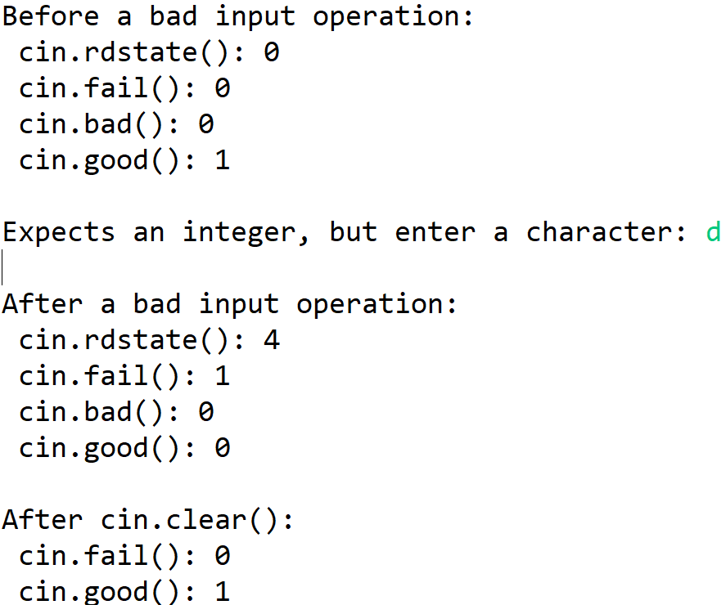
Stream Error
cin.rdstate(): 0 No error state is set.
cin.fail(): 0 No failure has occurred.
cin.bad(): 0 The bad bit is not set.
cin.good(): 1 The stream is in a good state.
cin.rdstate(): 4 The 'failbit' is set.
cin.fail(): 1 A failure occurred during input.
cin.bad(): 0 The bad bit is not set.
cin.good():0 The stream is not in a good state.
cin.fail(): 0 The failure state has been cleared.
cin.good(): 1 The stream is now in a good state.

Slide 27
Questions?

